Slide 1
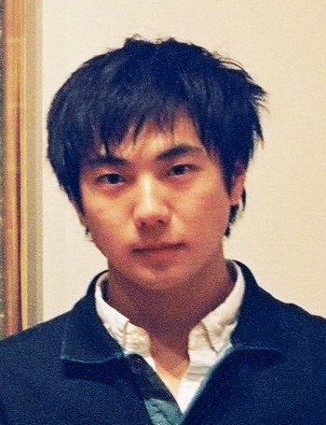
Generating Handwriting via
Decoupled Style Descriptors
Atsunobu Kotani
Stefanie Tellex
James Tompkin
Notes:
In this video, we introduce our paper, “generating handwriting via decoupled style descriptors” by Atsunobu kotani, Stefanie Tellex, James Tompkin from Brown University Computer science department.
Reproducing fine details in handwriting requires precise preservation of a writer’s style. In our paper, we introduce a new approach to model styles of online handwriting.

Slide 2
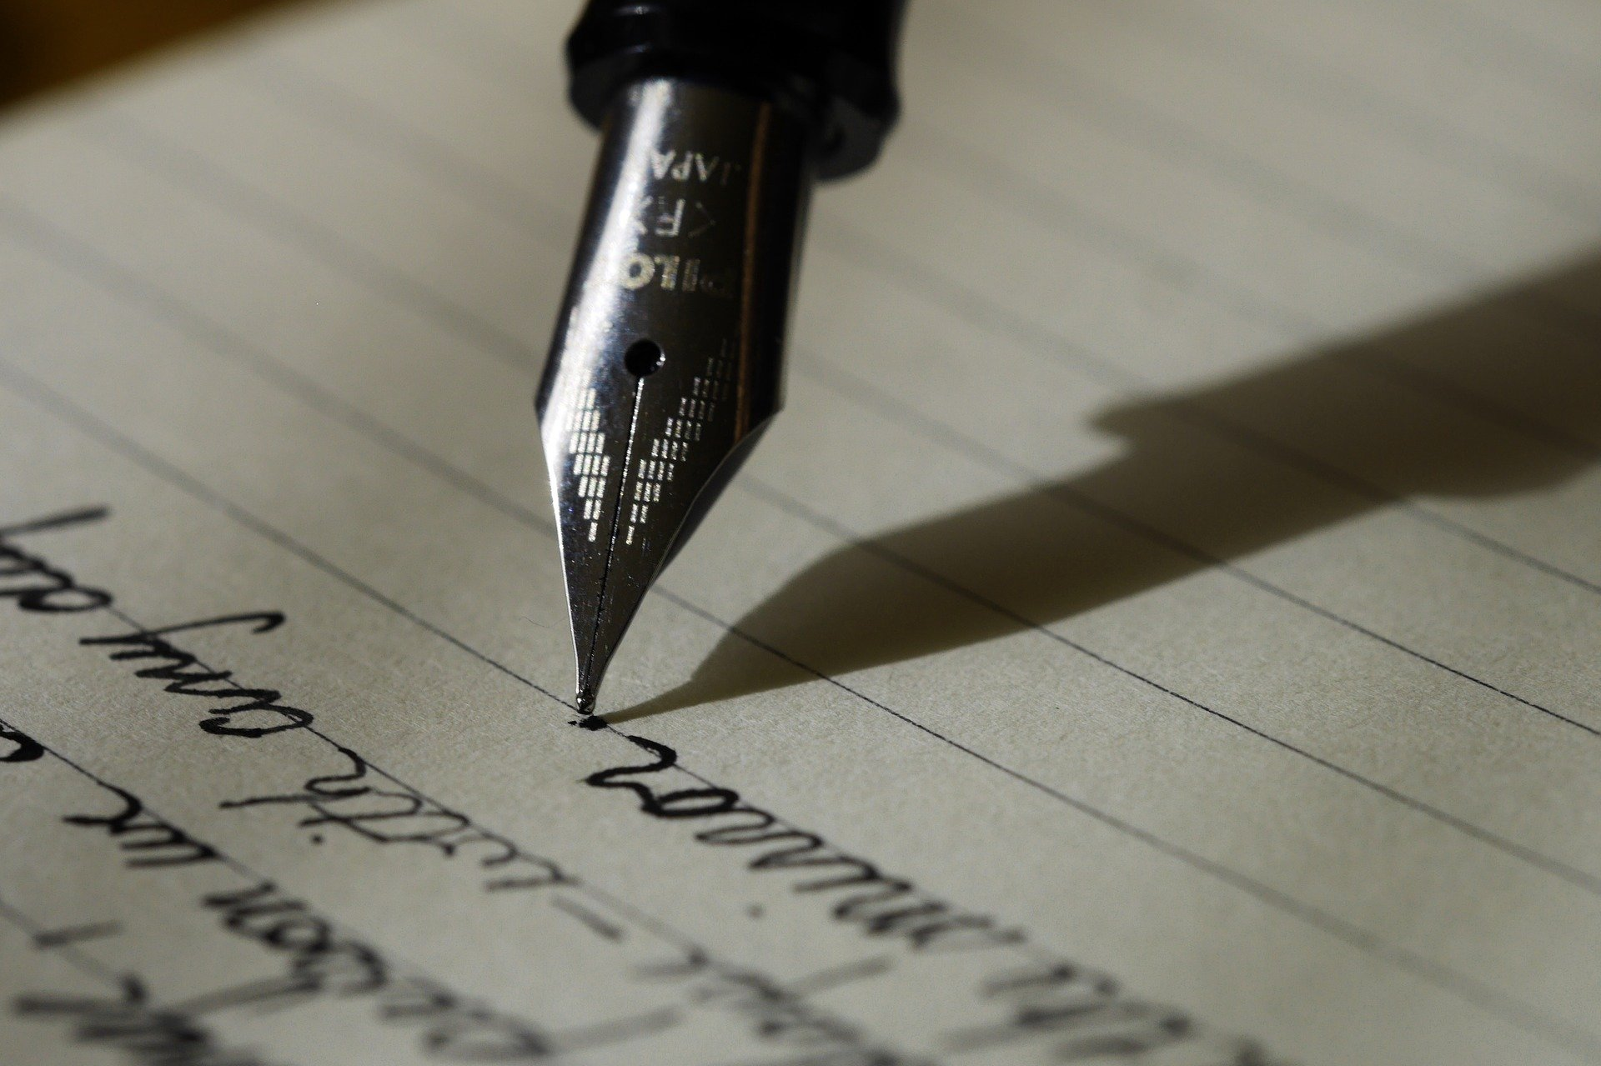
‹#›
Notes:
Producing computational models of handwriting is a deeply human and personal topic—

Slide 3
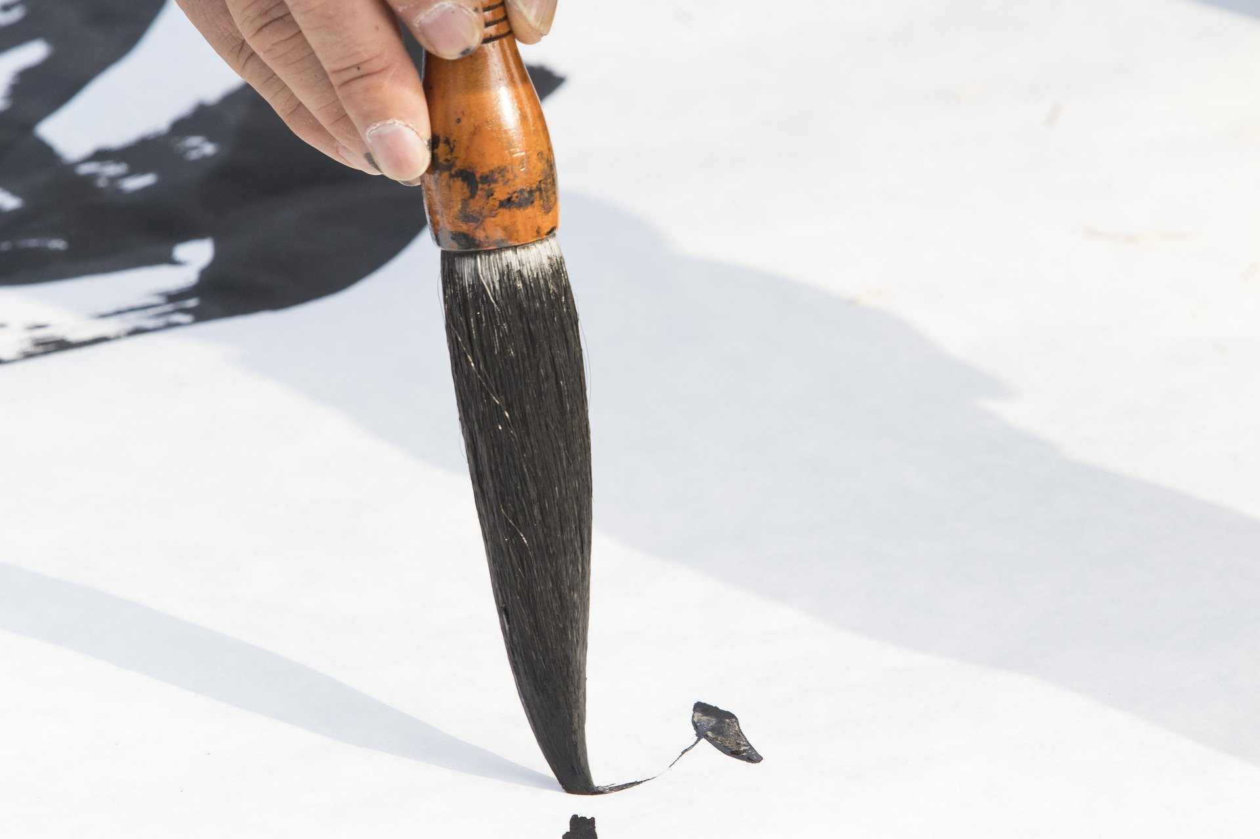
‹#›
Notes:
most people can write, and each writer has a unique style to their script.

Slide 4
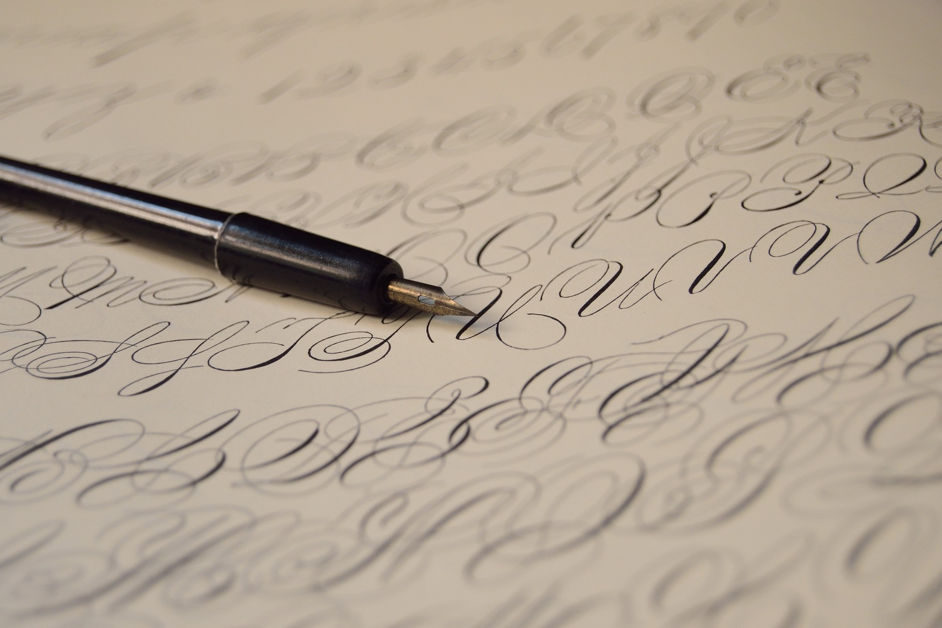
‹#›
Notes:
Capturing these styles flexibly and accurately is important as it determines the space of descriptive expression of any computational model.

Slide 5
‹#›
Notes:
For deep-learning-based models, our concern is how to architecture the neural network
such that we can represent the underlying stroke characteristics of the styles of writing. But, once we have a representation, this then lets us generate new writing in a style recovered from a previously-unseen target sample of writing,

Slide 6
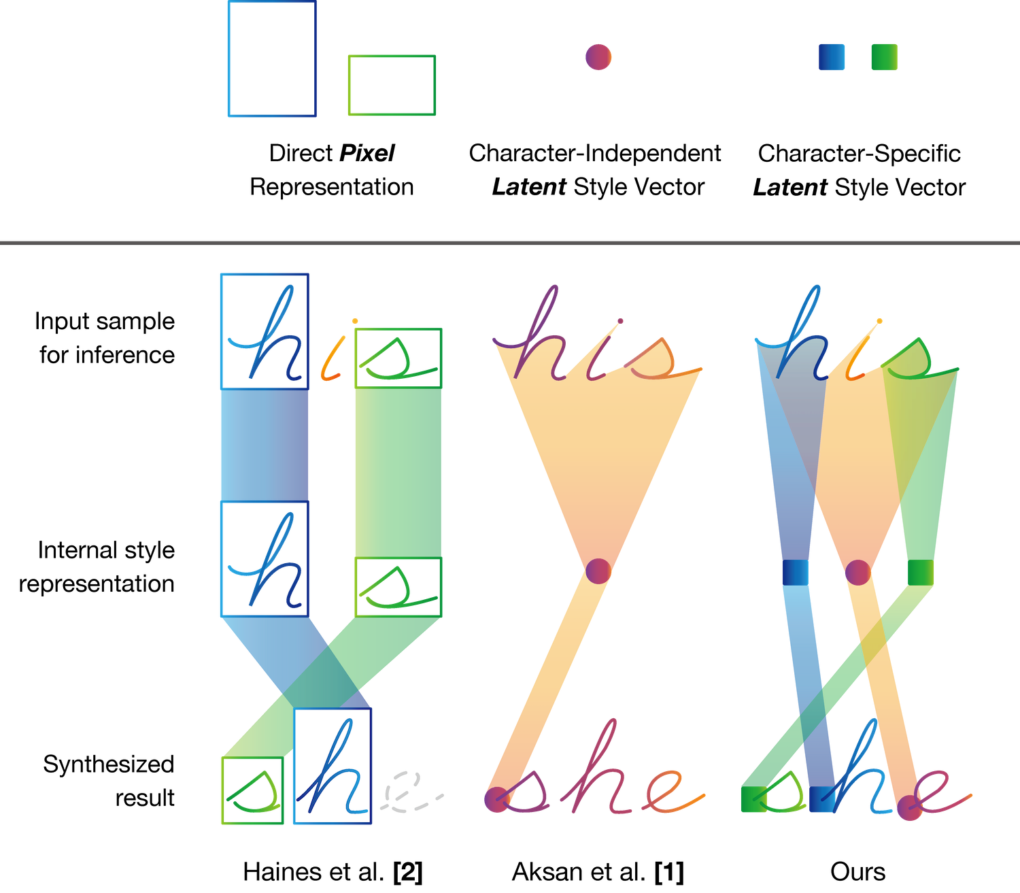
Handwriting generation:
Pixel representation [2]
[1] Aksan, E., Pece, F., Hilliges, O.: DeepWriting: Making Digital Ink Editable via Deep Generative Modeling. SIGCHI (2018). [2] Haines, T.S.F., Mac Aodha, O., Brostow, G.J.: My text in your handwriting. ACM Trans. Graph. 35(3) (May 2016).
Notes:
Techniques have synthesized handwriting from pixel samples. In this example, the goal is to generate a drawing of “she” from a sample “his”. As two characters “h” and “s” are common, these approaches extract specific regions and place them to look like a word.

Slide 7
Handwriting generation:
Pixel representation [2]
Learned by neural networks [1]
[1] Aksan, E., Pece, F., Hilliges, O.: DeepWriting: Making Digital Ink Editable via Deep Generative Modeling. SIGCHI (2018). [2] Haines, T.S.F., Mac Aodha, O., Brostow, G.J.: My text in your handwriting. ACM Trans. Graph. 35(3) (May 2016).
Notes:
There are also approaches to generate handwriting from features learned by neural networks such as latent style vectors. Pixel-based approaches are scalable, as their performance improves with more reference samples, which provide more variations in generated results. Current Latent vector approaches use Variational Recurrent Neural Networks to learn latent representations of handwriting styles, and shows effectiveness in generating a drawing of a character absent from the reference sample.

Slide 8
Handwriting generation:
Pixel representation [2]
Learned by neural networks [1]
Limitations:
Generating missing characters
Generating fine details
[1] Aksan, E., Pece, F., Hilliges, O.: DeepWriting: Making Digital Ink Editable via Deep Generative Modeling. SIGCHI (2018). [2] Haines, T.S.F., Mac Aodha, O., Brostow, G.J.: My text in your handwriting. ACM Trans. Graph. 35(3) (May 2016).
Notes:
However, pixel approaches cannot generate missing characters or interpolate between styles, and latent representations often lose fine details.
The approach of treating handwriting style as a `unified’ property of a sequence can limit the representation of both character- and writer-level features.
This includes specific character details being averaged out to maintain overall writer style, and an reduced representation space of writing styles.

Slide 9
Underlying problem: No explicit separation of writer style from character style.
[1] Aksan, E., Pece, F., Hilliges, O.: DeepWriting: Making Digital Ink Editable via Deep Generative Modeling. SIGCHI (2018). [2] Haines, T.S.F., Mac Aodha, O., Brostow, G.J.: My text in your handwriting. ACM Trans. Graph. 35(3) (May 2016).
Notes:
In other words, the problem with current methods is that there is no explicit separation of writer style from character style.
For instance, for character style, ‘h’ can be written with or without a loop (where we see the one on the slide here with a loop), and for writer style, ‘h’ could be large or small or slanted or squarer.

Slide 10
We learn to decouple writer and character style into specific vectors.
[1] Aksan, E., Pece, F., Hilliges, O.: DeepWriting: Making Digital Ink Editable via Deep Generative Modeling. SIGCHI (2018). [2] Haines, T.S.F., Mac Aodha, O., Brostow, G.J.: My text in your handwriting. ACM Trans. Graph. 35(3) (May 2016).
Notes:
Our approach, by contrast, learns to decouple writer and character style into specific vectors, such that we have both a character-independent style vector for each writer for any unsampled subsequences (magenta dot), and character specific latent style vectors if we’re given those samples (green and blue squares).

Slide 11
Problem statement
Desired output data:
Writer-independent character style representation C_{‘h’}
Character-independent writer style representation w
Character style representation
Writer style representation
C_{‘h’}
w
Method
Notes:
Our objective is to train neural networks which output a writer-independent character style representation C, And a character-independent general handwriting style representation of a writer w

Slide 12
Problem statement
Desired output data:
Writer-independent character style representation C_{‘h’}
Character-independent writer style representation w
Input data:
Strokes as point sequences (x, y, t)
Character labels as one-hot vectors
Character style representation
Writer style representation
C_{‘h’}
w
Method
Notes:
However, our only input is a sequence character labels and a set of strokes that are the handwriting - this handwriting already couples the writer and character styles. So, we must learn to decouple them somehow.

Slide 13
Decoupled Style Descriptors (DSD)
We learn a linear relationship between - Writer-DSD w and - Character-DSD C_{‘h’}
Notes:
To do this, we introduce ‘Decoupled Style Descriptors’ or DSDs, which is designed to decouple style representations.
In our handwriting setting, we assume writer style and character style are linear.

Slide 14
Decoupled Style Descriptors (DSD)
We learn a linear relationship between - Writer-DSD w and - Character-DSD C_{‘h’}
Notes:
Here’s the high-level diagram. Input character label ‘h’ is transformed into Character-DSD matrix C_h,

Slide 15
Decoupled Style Descriptors (DSD)
We learn a linear relationship between - Writer-DSD w and - Character-DSD C_{‘h’}
Notes:
this is then multiplied by the character-independent general writer style, Writer-DSD w

Slide 16
Decoupled Style Descriptors (DSD)
We learn a linear relationship between - Writer-DSD w and - Character-DSD C_{‘h’}
Notes:
to produce the instantiation of that character written by that writer, w_h, which we will call the ‘Writer-Character-DSD’.

Slide 17
Decoupled Style Descriptors (DSD)
We learn a linear relationship between - Writer-DSD w and - Character-DSD C_{‘h’} through learned LSTM encoders g_{θ} and f_{θ}.
Notes:
This happens through learned LSTM encoders g and f, and we predict Character-DSD matrix C from a character label and Writer-Character-DSD from a sequence of points.

Slide 18
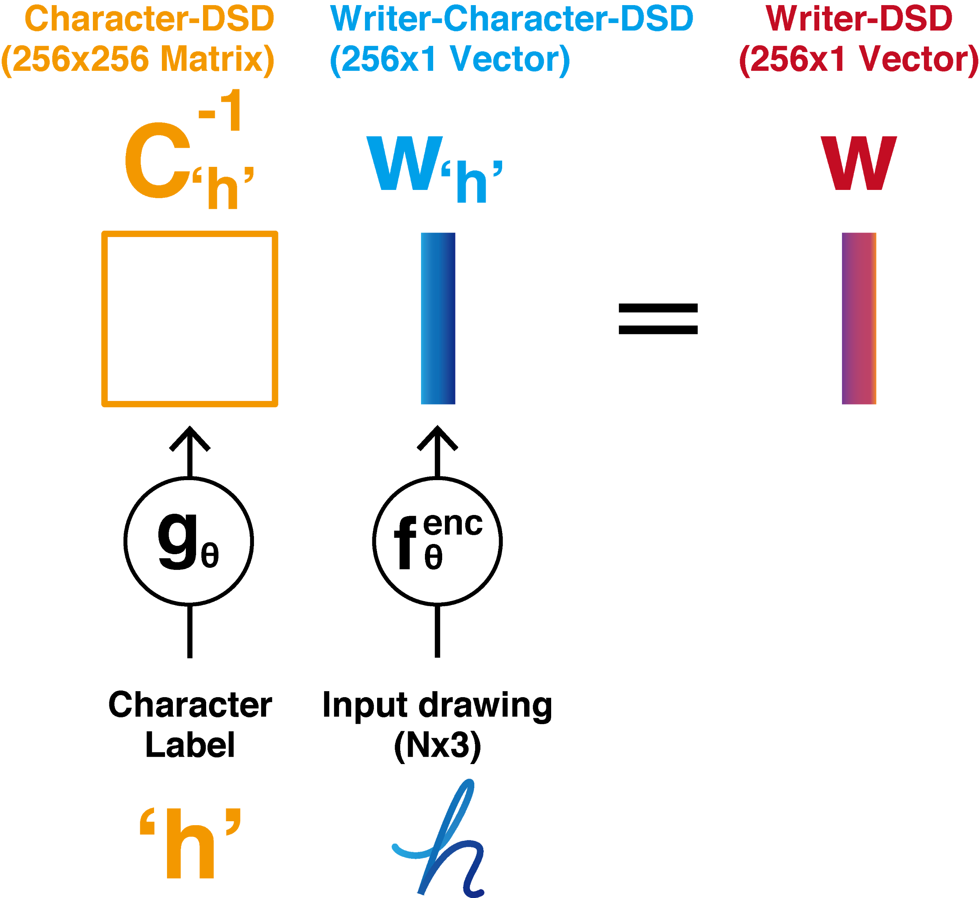
Decoupled Style Descriptors (DSD)
We learn a linear relationship between - Writer-DSD w and - Character-DSD C_{‘h’} through learned LSTM encoders g_{θ} and f_{θ}. Simply invert C_{‘h’} to recover w from w_{‘h’}.
Notes:
Because Character-DSD is an invertible matrix, to recover the writer’s style `w’ from a pair of character-DSD and writer-character-DSD, we can simply invert the matrix.
Intuitively, a matrix multiplication either injects or ejects character information from a latent vector. Now, once we have obtain the Writer-DSD, we can generate arbitrary text with it.

Slide 19
Decoupled Style Descriptors (DSD)
We learn a linear relationship between - Writer-DSD w and - Character-DSD C_{‘h’} through learned LSTM encoders g_{θ} and f_{θ}. Simply invert C_{‘h’} to recover w from w_{‘h’}.
Retains more fine detail. Allows few-shot learning for new characters, and writer identification.
Notes:
This decoupling retains more fine details in the handwriting, and allows few-shot learning of new characters and writer identification.

Slide 20
Decoupled Style Descriptors (DSD)
At the core, we have LSTM-based autoencoder, similar to the work by Graves [3].
[3] Graves, A.: Generating sequences with recurrent neural networks. arXiv preprint arXiv:1308.0850 (2013)
Notes:
We now go over the model architecture. At the core of our design, as highlighted in blue, we have an LSTM-based autoencoder, similar to the work by Graves.
This is a very simple problem to solve; we can simply aim to minimize the reconstruction loss for input sequence.
Our model builds upon this simple architecture.

Slide 21
Decoupled Style Descriptors (DSD)
Notes:
As we have already seen, two parameterized function approximators f_theta^encoder and g_theta transforms an input sequence of points and a character label into a Writer-Character-DSD vector and a Character-DSD matrix.

Slide 22
Decoupled Style Descriptors (DSD)
Notes:
We then compute the inverse of the predicted Character-DSD matrix,

Slide 23
Decoupled Style Descriptors (DSD)
Notes:
And multiply it with Writer-Character-DSD to filter out character information.

Slide 24
Decoupled Style Descriptors (DSD)
Notes:
When a writer-DSD is multiplied with the original Character-DSD, we inject character information and reconstruct the writer-character-DSD.

Slide 25
Decoupled Style Descriptors (DSD)
Notes:
And with the sequence decoder f_theta^decoder, we can reconstruct the drawing from writer-character-DSD vectors

Slide 26
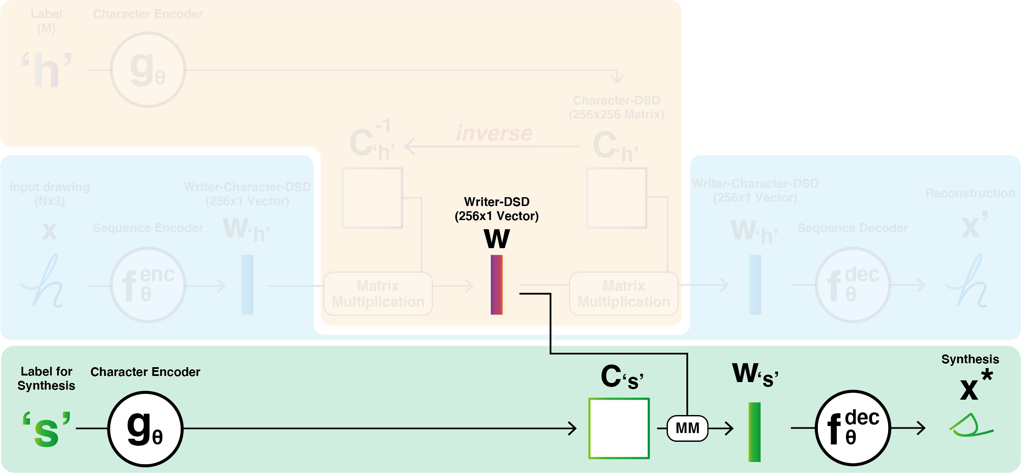
Decoupled Style Descriptors (DSD)
Notes:
For a new drawing synthesis, the writer-DSD produces a new Writer-Character-DSD when multiplied with another predicted character-DSD matrix for a new character.

Slide 27
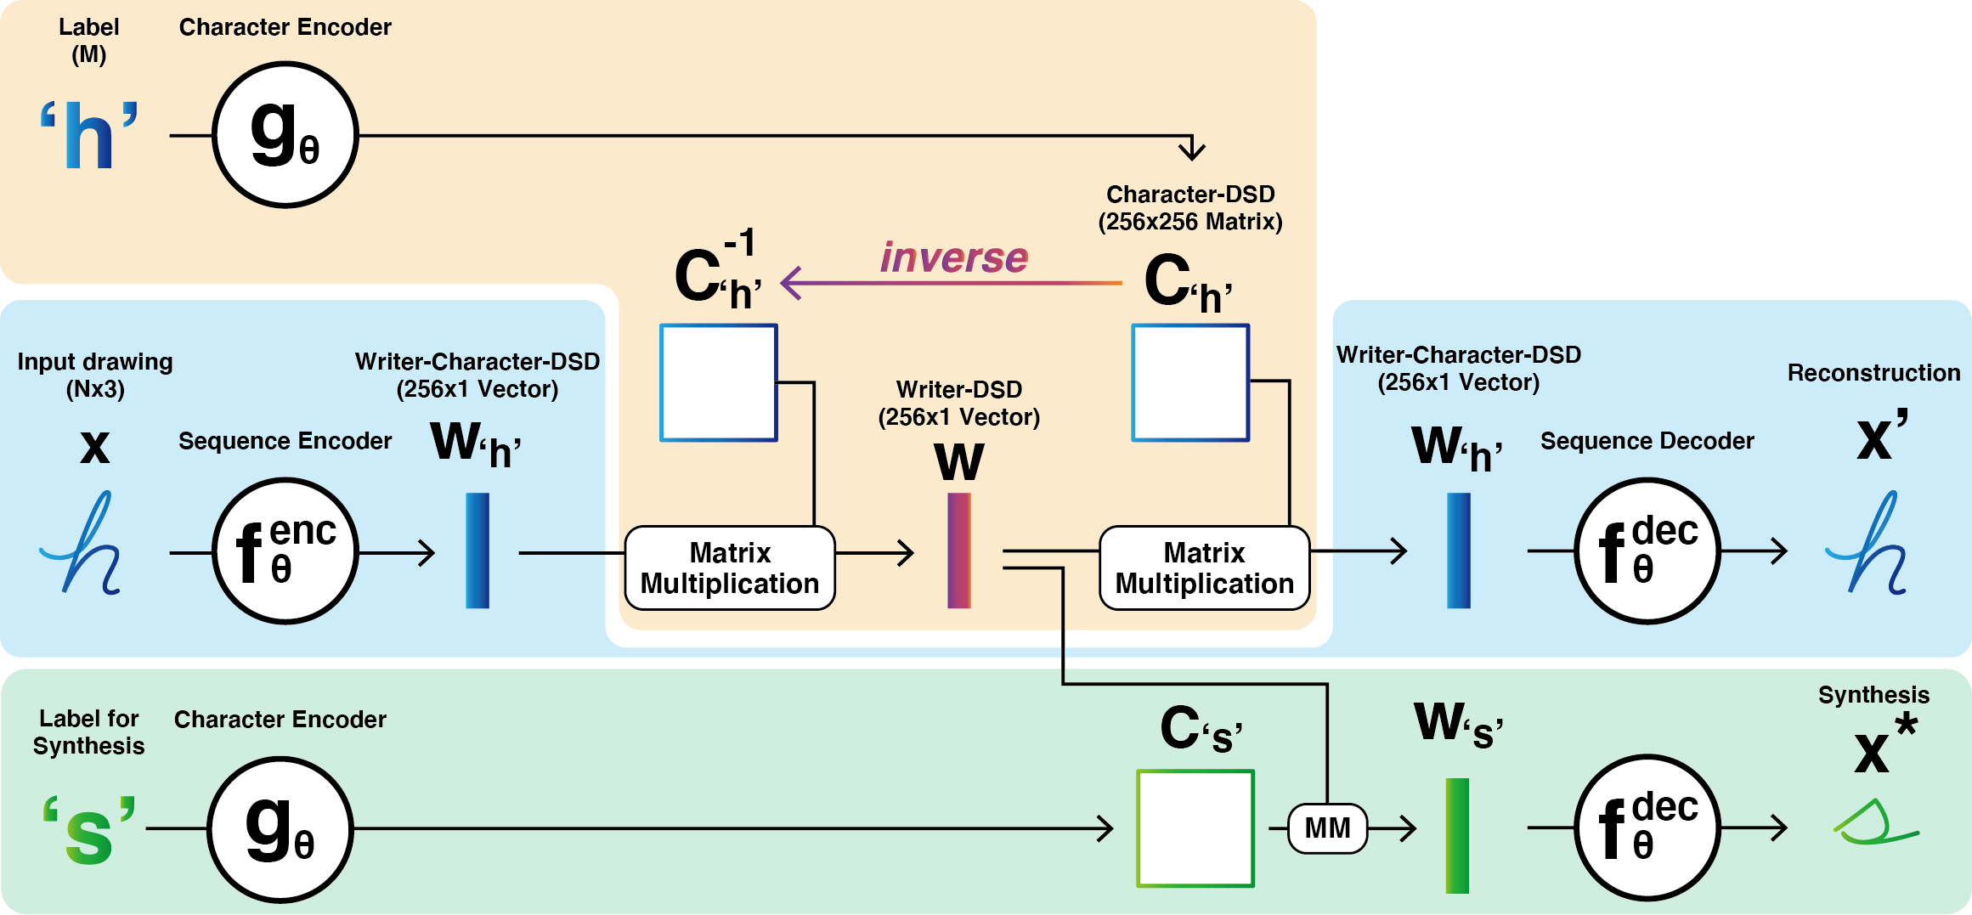
Decoupled Style Descriptors (DSD)
Notes:
This is the high-level overview of our model architecture.
(wait for an extra few seconds for viewers to see the full picture)
Removed (But some of you may ask; how can character-encoder be trained to output a meaningful character representation?
In this figure, the values of Character-DSD do not seem to be so important because with C matrix being invertible, two writer-character-DSDs become the same. First multiplied with a matrix and then with its inverse, Writer-Character-DSD does not change its values. We would like to emphasize that it will not occur in our actual training as this figure shows a very special case of training data; a single character drawing with a single character label. As we batch-train our model, Writer-DSD is computed slightly different from this figure.)

Slide 28
Subsequences rather than single characters
Writing is complex: - Cursive - Character pairs (ligatures) - Delayed strokes (f, t, i, j)
Notes:
Writing is complex, with cursive, character pair ligatures, and delayed strokes. No single-character model can easily represent these.

Slide 29
Subsequences rather than single characters
Writing is complex: - Cursive - Character pairs (ligatures) - Delayed strokes (f, t, i, j)
Our approach actually represents latent space of all subsequences of characters. Word ‘his’ has representations C_{‘h’}, C_{‘hi’}, and C_{‘his’}. and w_{‘h’}, w_{‘hi’}, and w_{‘his’}.
Notes:
In the previous diagrams, we use a single character, but in truth our LSTM encoder function `g’ represents not only a single character but also a character string.
Thus, for the word ‘his’, we will have a C matrix for substrings `h’, `hi’ and `his’.
This is also true for the Writer-Character-DSD w_h, w_hi, and w_his, as input drawings can contain multiple characters.

Slide 30
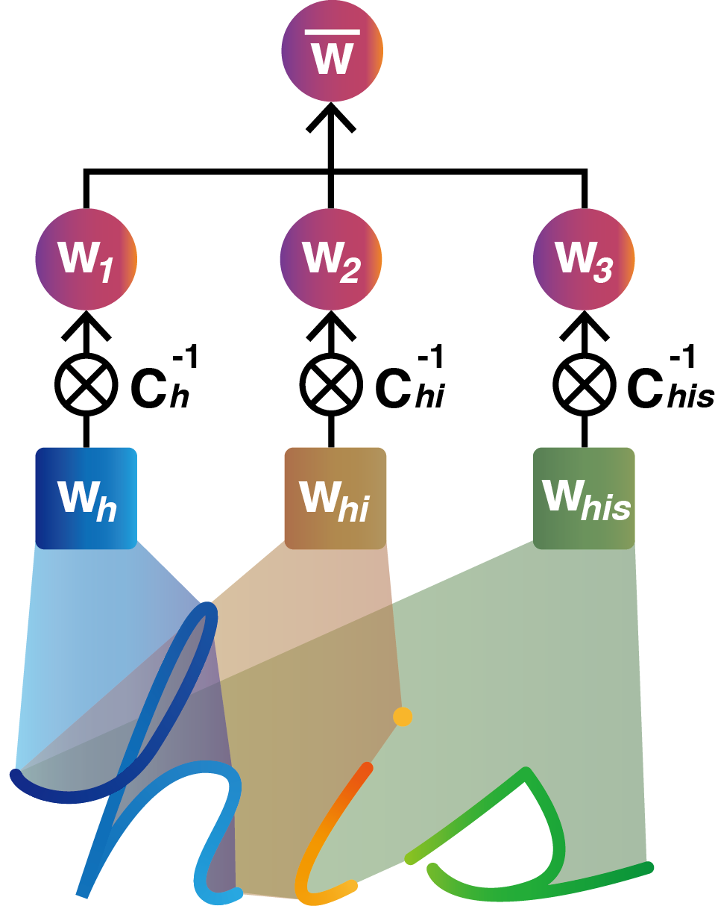
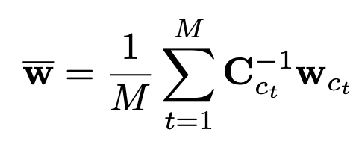
Recovering Writer-DSD w from handwriting samples
Take mean w over subsequences:
Notes:
From a drawing of three characters “h”, “i”, “s”, we will obtain three writer-character DSDs, w_h, w_hi and w_his with f_theta^encoder.
When multiplied with their corresponding character-DSD matrices, they will create three candidates for Writer-DSD, w1, w2 and w3.
We compute the mean average of these three vectors and use it as our writer-DSD.
(Removed as well) This averaging process solves the problem earlier.
When we try to reconstruct the Writer-Character-DSD, the results will now be different and C needs to be learned well.

Slide 31
Generating handwriting using a global Writer-DSD w
Given a target word ‘his’:
Predict C_{‘h’}, C_{‘hi’}, and C_{‘his’}
Multiply by w to create w_{‘h’}, w_{‘hi’}, and w_{‘his’}
Decode (w_{‘h’,} w_{‘hi’,} w_{‘his’}) into stroke sequence
Notes:
Given the mean Writer-DSD w-bar, we can reconstruct the target Writer-Character-DSD for generation.
First predict Character-DSD matrices Ch Chi Chis and multiply them with w-bar to create Writer-Character-DSDs wh whi whis.
We then generate a stroke sequence with f_theta decoder from this set of vectors.

Slide 32
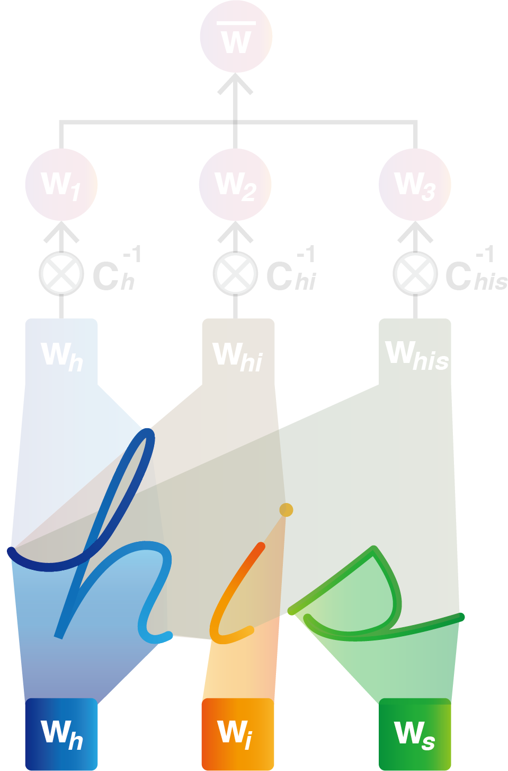
Single-character Writer-Character-DSD
There are relatively few single-character w_{‘h’}.
If we extract them from a writing sample, we can save them in a database and sample them during generation.
Notes:
However, we can also extract Writer-Character-DSDs for a single character, if drawing is non-cursive.
Single-character Writer-Character-DSDs, such as w_h, w_i and w_s in the figure, are good representations as they are sufficiently few compared to all possible words. Also we can save them in a database and use them to synthesize a new sample if the character is present in the target text.

Slide 33
Generating handwriting using sampled Writer-Character-DSD
Retrieve relevant single-characters w_{‘h’}, w_{‘i’}, w_{‘s’}.
Restore temporal dependencies via LSTM.
LSTM
Cannot cope with any missing characters in reference handwriting samples.
Notes:
With these Writer-character-DSDs for substrings, we can reconstruct writer-character-dsds for generation by restoring temporal dependencies among them with LSTM shown as a green rectangle.

Slide 34
Combined method with sampling
Reference sample: ‘his’ Generation target: ‘she’
Compute mean w from all substrings
Predict w_{‘e’} with C_{‘e’} and the mean w
Extract single-character Writer-Character-DSDs
Restore temporal dependencies with LSTM.
LSTM
Notes:
Upon successful training of these two methods, we can combine them and generate a high-quality drawing in runtime.
Let us assume we have a reference drawing of non-cursive `his’ and aims to generate a drawing of `she’.
We first compute the mean w from pairs for writer-character-DSD and Character-DSD,
Predict a writer-character-DSD for a missing character `e’.
And as two characters `h’ and `s’ are common in `his’ and `she’, we extract two single-character Writer-Character-DSDs, w_s and w_h.
Finally, we feed them into LSTM and restore temporal dependencies.

Slide 35
Generated Results
Colored characters match between provided writing samples and desired output.
These are generated from retrieved w_{‘h’}
Missing characters are generated from global w

Slide 36
Generated Results
Notes:
These are generated results by our trained model. To generate handwriting samples, our model used 10 reference samples by the same writer.
Without ever seeing the target drawing, both of our methods generate high-quality samples while preserving fine details.
There is a slight improvement in quality with our sampling method, as it saves Writer-Character-DSD in a database. When Writer-Character-DSD for a certain substring in the target text exists in a database, it is highly likely to succeed in generating accurate transitions from one character to another.

Slide 37
Generated Results - Comparison
[1] Aksan, E., Pece, F., Hilliges, O.: DeepWriting: Making Digital Ink Editable via Deep Generative Modeling. SIGCHI (2018).
Notes:
When compared against the SOTA model in online handwriting synthesis, our results were preferred 88% of the time.
Not only the overall size of handwriting but also connections between characters and unique drawings of certain characters are well-preserved.

Slide 38
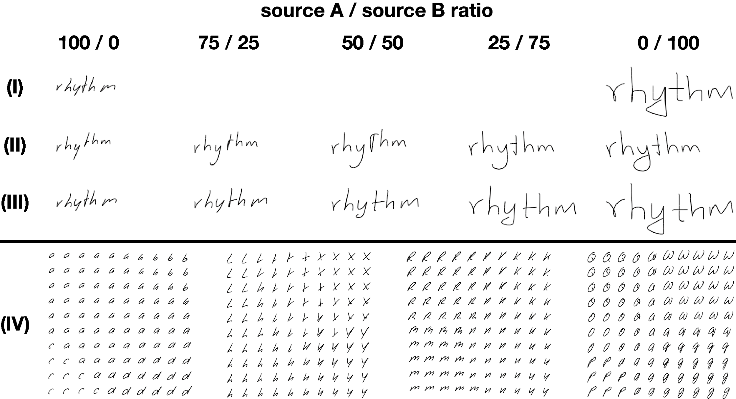
Interpolation
True samples
Writer-DSD level
Writer-Character-DSD level
Character-DSD level
Notes:
Our style representations can be interpolated between two drawings.
Here we have two sample drawing of `rhythm’ by two writers.

Slide 39
Interpolation
True samples
Writer-DSD level
Writer-Character-DSD level
Character-DSD level
Notes:
From each sample, we can compute the mean Writer-DSD w and mix them together to obtain a new Writer-DSD.
We can observe a style of drawing slowly changes from one to another by altering the mix ratio.

Slide 40
Interpolation
True samples
Writer-DSD level
Writer-Character-DSD level
Character-DSD level
Notes:
As two source drawings are non-cursive, we can also sample writer-character-DSDs for each character. We mix them in a similar manner to create a new Writer-Character-DSD, which will be then fed into LSTM and sequence decoder. As this is an interpolation at a single character level, the style transition is relatively smoother than the previous example.

Slide 41
Interpolation
True samples
Writer-DSD level
Writer-Character-DSD level
Character-DSD level
Notes:
Finally, we can also interpolate at character-DSD level. In these examples, we compute 4 Character-DSDs for 4 characters and construct a new C matrix. Writer-DSD is fixed in this interpolation, and we reconstruct writer-character-DSD from a new C matrix and the writer-DSD. From this set of experiments, we show our style space is smooth.

Slide 42
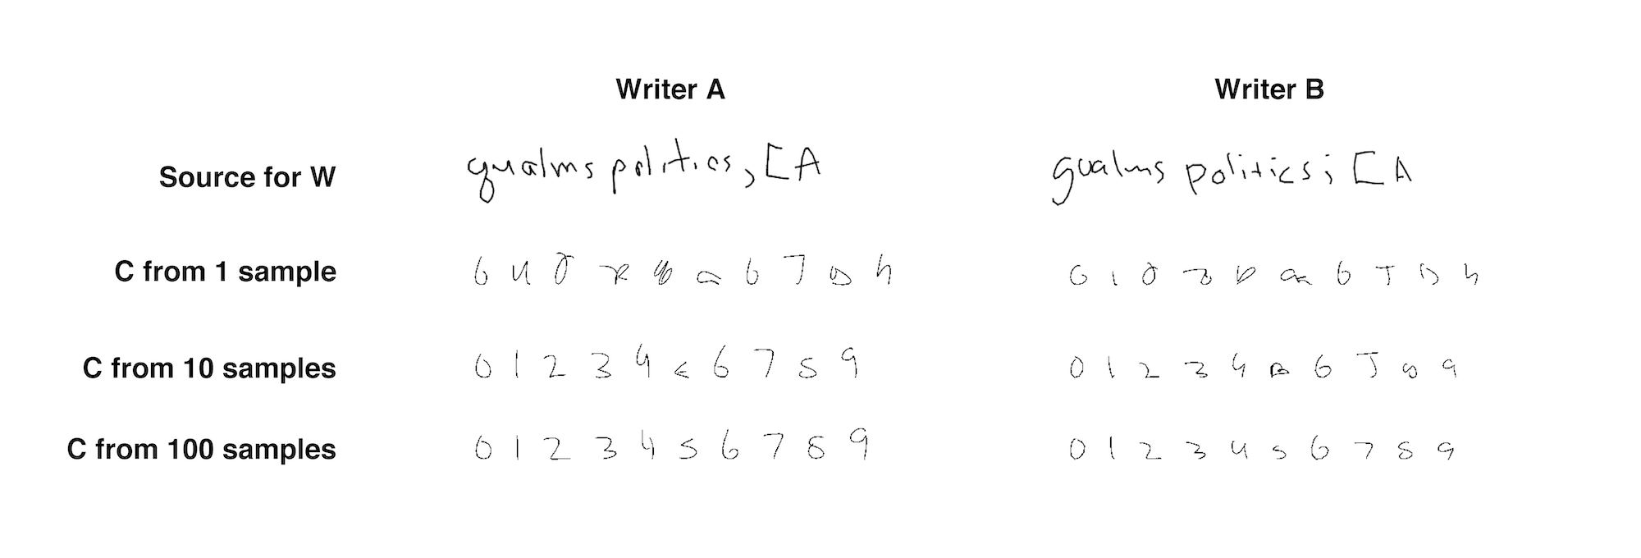
Few-shot learning of New Characters
Notes:
A linear relationship between three DSDs lets us to perform few-shot learning of new characters. We first excluded samples including numerical letters from our dataset and trained a model prior to this experiment. We then provide a few drawing samples of numbers to the model and predict Writer-Character-DSD for these letters. Assuming the writer of numerical letters also provided other roman alphabet samples, which allow us to predict Writer-DSD w. The pairs of Writer-Character-DSD and Writer-DSD allows us to predict the Character-DSD, and the figure shows the results. As we provide more samples per new character, the quality improves, but predicting a good Character-DSD from a single sample remained difficult. However, we can observe stylistic differences in generated samples, such as the character 4 in 100 samples prediction.

Slide 43
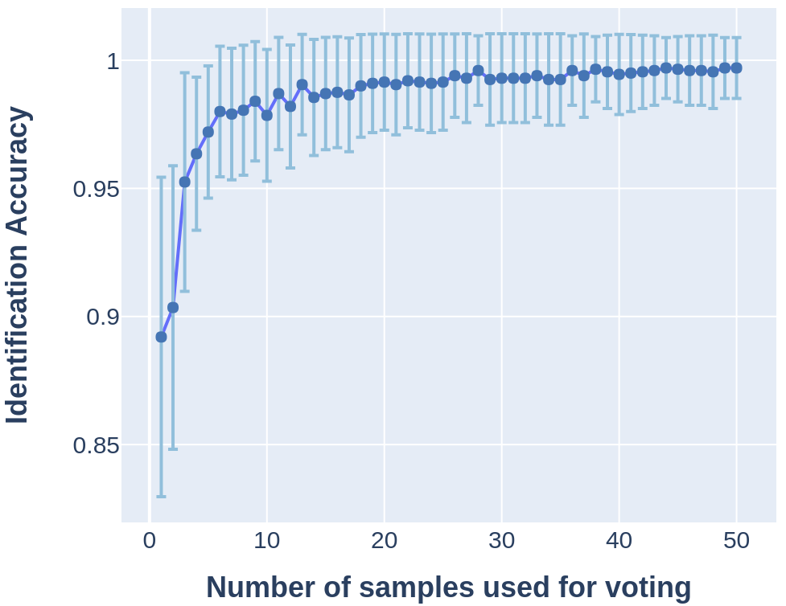
Writer Identification
In a 20-writer identification task, our model achieved:
89.20% ± 6.23 for 1 word sample 99.70% ± 1.18 for 50 word samples
Notes:
To examine how well our model might represent the latent distribution of handwriting styles, we perform a writer recognition task on our trained model
on the randomly-selected 20-writer hold out set from our dataset. First, we compute 20 writer DSDs from 10 sentence-level samples.
Then, for testing, we sample from 1 to 50 new word-level stroke sequences per writer and calculate the corresponding writer-DSDs.
Our test prediction accuracy rises from 89.20% for one word sample, to 99.70% for 50 word samples.
This is an indication that our latent space is usefully descriptive.

Slide 44
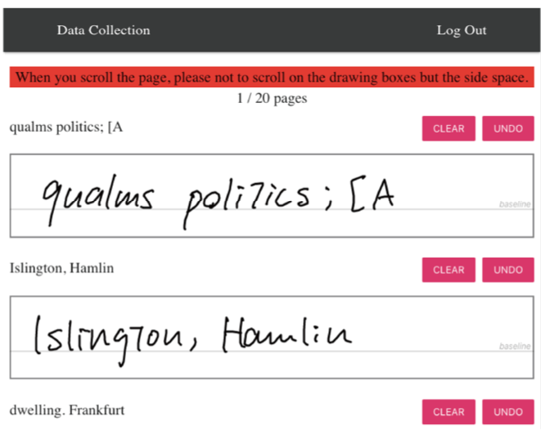
BRUSH dataset
BRUSH dataset contains handwriting of:
170 writers, 86 Latin alphabet characters
488 common words written by all writers
99.5% coverage of two-character letter space
+ 3668 rarer words written across writers
99.9% coverage in total
Notes:
We are also releasing a new dataset for online handwriting, which we name the BRUSH dataset.
It is comprised of handwritten digital strokes in the Latin alphabet, which includes 170 writers, 86 characters,
488 common words written by all writers, and 3668 rarer words written across writers.
In two-character letter space, the common words cover 99.5% and with additional words it covers 99.9% of the space.

Slide 45
BRUSH dataset
BRUSH dataset contains handwriting of:
170 writers, 86 Latin alphabet characters
488 common words written by all writers
99.5% coverage of two-character letter space
+ 3668 rarer words written across writers
99.9% coverage in total
Common word samples & character-level labels are not present in IAM dataset [4].
[4] Marti, U.V., Bunke, H.: The iam-database: an english sentence database for offline handwriting recognition. IJDAR (2002).
Notes:
Further, our drawing samples are segmented into characters. Common word samples & Character-level labels are not present in IAM dataset.

Slide 46
Generating Handwriting via Decoupled Style Descriptors Atsunobu Kotani, Stefanie Tellex, James Tompkin
Contributions:
DSDs decouple character style from writer style.
Allow flexible handwriting generation.
BRUSH: new dataset for online handwriting.
Code & dataset available at
http://dsd.cs.brown.edu
Notes:
In this talk, we discussed Generating Handwriting via Decoupled Style Descriptors.
DSDs decouple character style from writer style and allow flexible handwriting generation.
We also introduced the new BRUSH dataset for online handwriting.

Slide 47
Generating Handwriting via Decoupled Style Descriptors Atsunobu Kotani, Stefanie Tellex, James Tompkin
Contributions:
DSDs decouple character style from writer style.
Allow flexible handwriting generation.
BRUSH: new dataset for online handwriting.
Potential Extension:
Explicit decoupling may work better than implicit decoupling / disentanglement.
DSDs could be applied to other sequential data (e.g. speech, motion capture data)
Code & dataset available at
http://dsd.cs.brown.edu
Notes:
We have shown explicit and structural style decoupling process work better than implicit decoupling process in our handwriting domain,
and the idea of DSD could be applied to other sequential data with style variations, such as speech and motion capture data.

